Slide 1
Lab 5
Dr : Ghada
Eng : Gehad Mustafa
Eng : Somaya

Slide 2
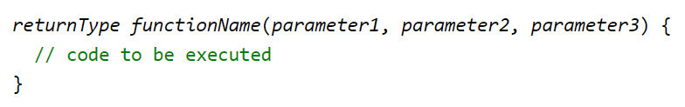
Parameters and Arguments
Information can be passed to functions as a parameter. Parameters act as variables inside the function.

Slide 3
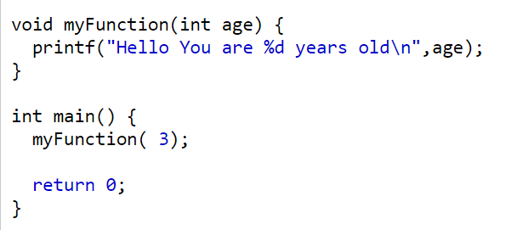

Void Function
Output

Slide 4
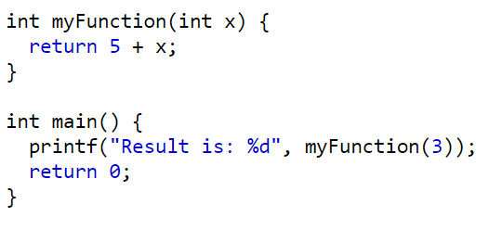

Int Function
Output

Slide 5
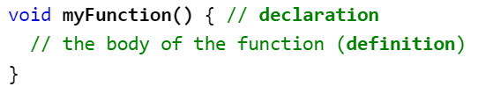
Function Declaration and Definition
Declaration: the function's name, return type, and parameters (if any)
Definition: the body of the function (code to be executed)
For code optimization, it is recommended to separate the declaration and the definition of the function.

Slide 6
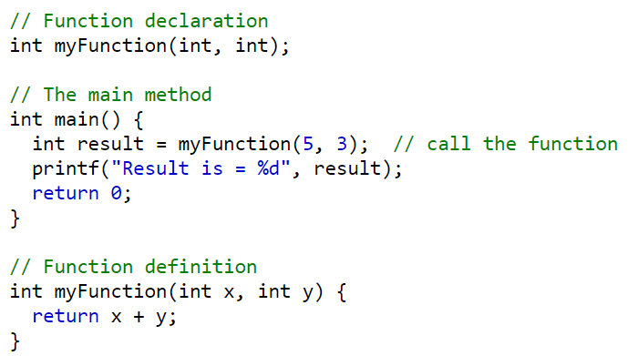

Function Declaration and Definition
Output

Slide 7
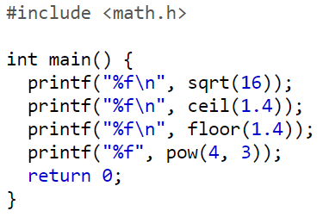
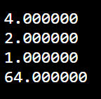
Math Functions
Output

Slide 8
Try
Write a function to calculate the sum of n even integers starting from a given even integer.
Write a function to find the absolute value the integer parameter .
Write a function to takes a real number as its argument and return the sum of digits of this number.
Write a function isdigit which should return the digit if the given number is a digit and zero if not.

Slide 9
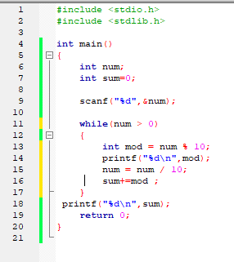

Slide 10
